Slide 1
A Second Order Feedback Network
for Single Image Super Resolution
學生 : 鄭人瑋
指導教授 : 張隆紋 教授

Slide 2
outline
Introduction
Related work
Proposed method
Experiments
Results
Conclusion

Slide 3
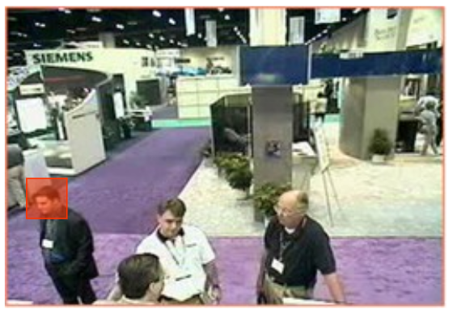
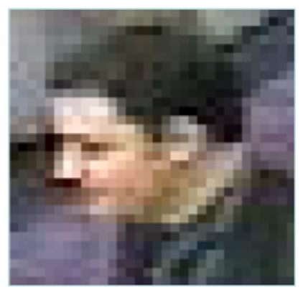

Introduction
Related work
Proposed method
Experiment
Result
Conclusion
Low resolution
High resolution

Slide 4
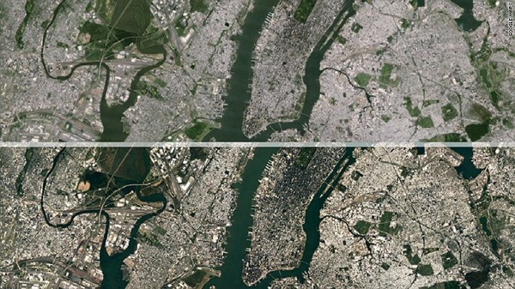
Introduction
low resolution
Related work
Proposed method
Experiment
Result
Conclusion
high resolution

Slide 5


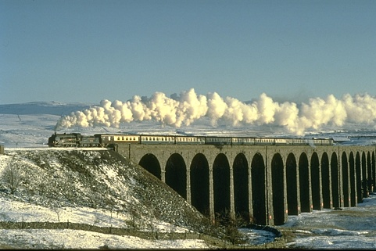

Introduction
Related work
Proposed method
Experiment
CNN-based Model
Result
Conclusion
Notes:
自從SRCNN提出後

Slide 6
Introduction
Related work
Most networks in the last few years are dedicated to deepening the networks depth to obtain better performance, but deeper network would lead to numerous parameters and need more storage.
A large number of parameters could result in overfitting problem.
Most SR networks only forward the low-resolution input straightly to the end to get the SR output.
Proposed method
Experiment
Result
Conclusion
Notes:
現在大部份的network有兩個主要缺點

Slide 7
Introduction
Related work
Therefore, the feedback architecture has been introduced in SR recently.
The feedback mechanism aims to carry the high-level information back to shallow layers to refine the low-level information.
Owing to the circulation structure, the feedback mechanism could reuse the hidden layers and accordingly reduce the parameters.
Proposed method
Experiment
Result
Conclusion

Slide 8
Introduction
Related work
We propose a new structure for image SR called second order feedback network (SOFN).
Design a feedback in feedback block (FIF) which consists of two feedback structures in a single network.
The inner loop aims to deepen the single sub-network depth to extract deeper features and the outer loop aims to feedback the HR information back to refine the front features.
Proposed method
Experiment
Result
Conclusion

Slide 9
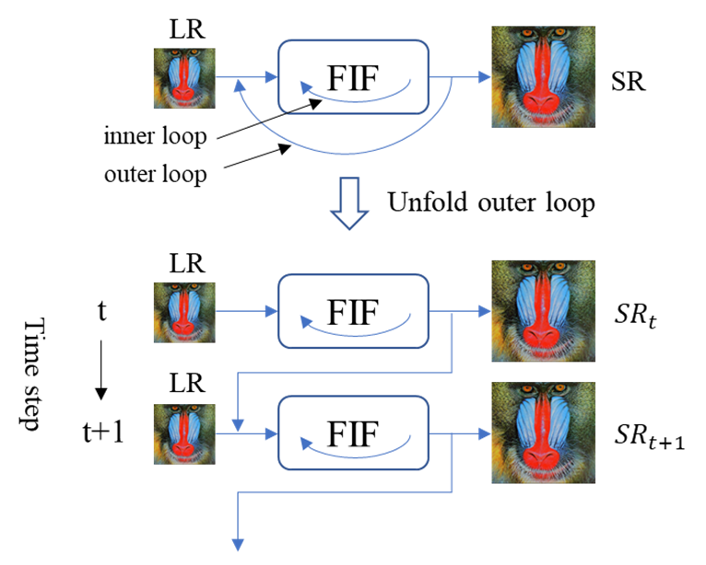
Introduction
Related work
Proposed method
Experiment
Result
Conclusion
Figure1. The schema of our double feedback mechanism.

Slide 10
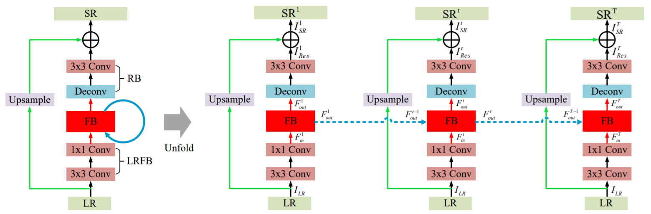
Introduction
Related work
SRFBN [1]
GMFN [2]
Proposed method
Experiment
Result
Conclusion
[1] Z. Li, J. Yang, Z. Liu, X. Yang, G. Jeon, W. Wu, “Feedback Network for Image Super-Resolution,”
In CVPR, 2019

Slide 11
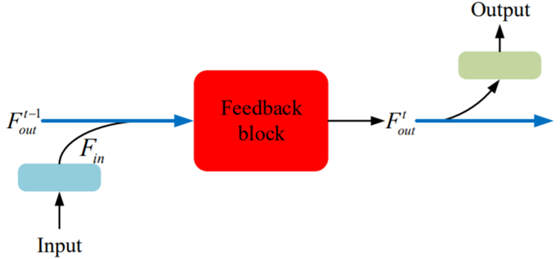
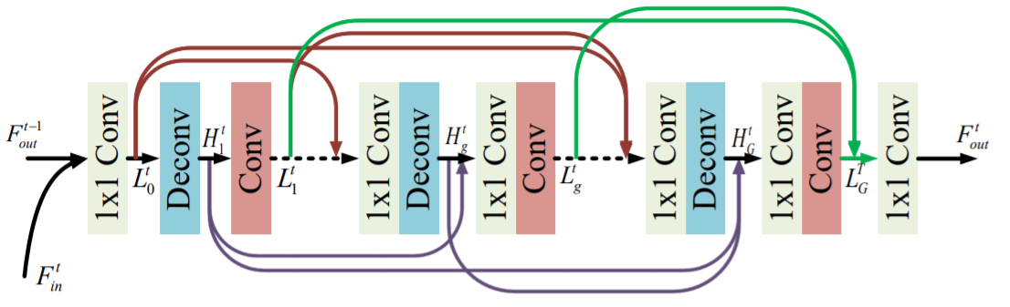
Introduction
Related work
SRFBN [1]
GMFN [2]
Proposed method
Experiment
Result
Conclusion
[1] Z. Li, J. Yang, Z. Liu, X. Yang, G. Jeon, W. Wu, “Feedback Network for Image Super-Resolution,”
In CVPR, 2019

Slide 12
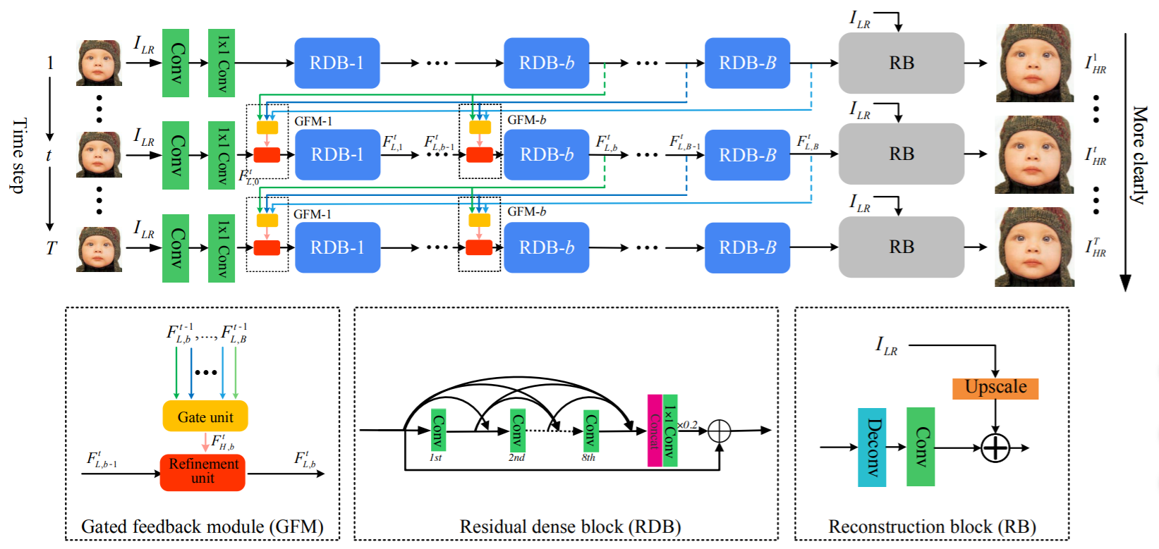
Introduction
Related work
SRFBN [1]
GMFN [2]
Proposed method
Experiment
Result
Conclusion
[2] Q. Li, Z. Li, L. Lu, G. Jeon, K. Liu, X. Yang, “Gated Multiple Feedback Network for Image Super-Resolution,”
In BMVC, 2019

Slide 13
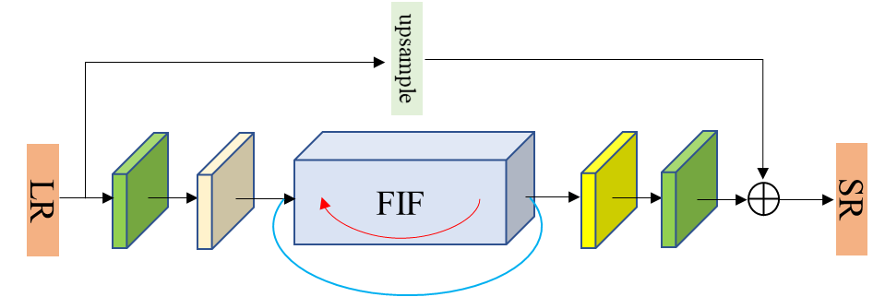
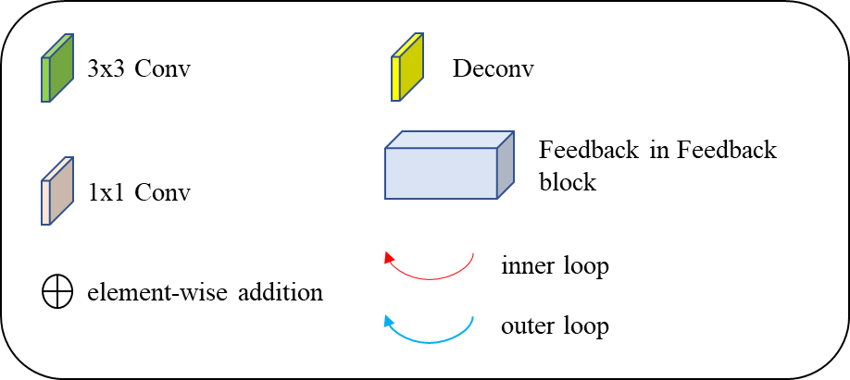
Introduction
Related work
Proposed method
Overview
Outer loop
Inner loop
CG
Experiment
Result
Conclusion
Figure 4. The proposed second order feedback network (SOFN)
Notes:
mainly three parts in a SOFN
Low-level feature extraction layers
FIF block
Upscale module

Slide 14
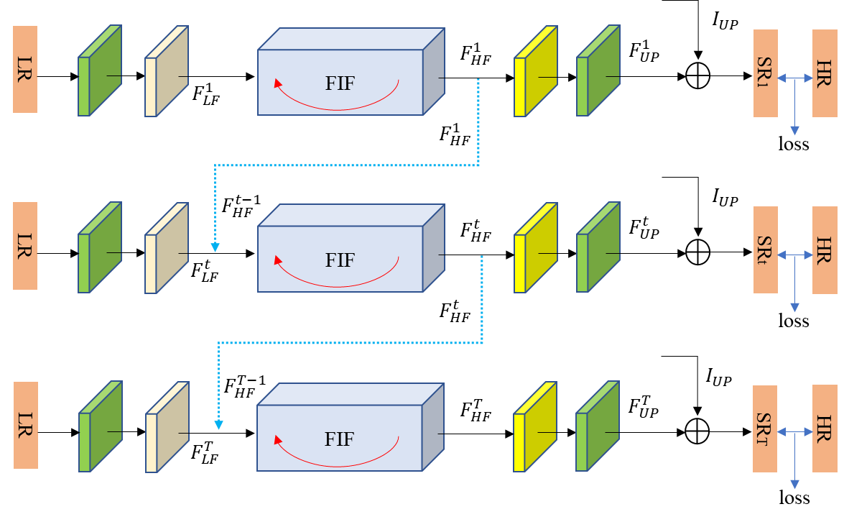
Introduction
Related work
Proposed method
Overview
Outer loop
Inner loop
CG
Experiment
Result
Conclusion
Notes:
把outer loop展開成T個時間點，我們可以把每個時間點的network當成是一個sub-network

Slide 15
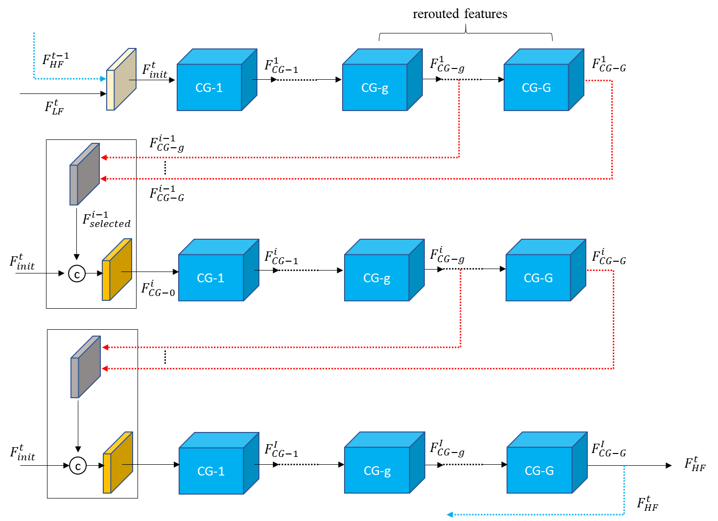
Introduction
Related work
Proposed method
Overview
Outer loop
Inner loop
CG
Experiment
Result
Conclusion
Notes:
Outer loop 是用 highest feedback，Ineer loop是用 multiple feedback
建構convolution group當作network骨架
每一個sub-network會對應I個iteration

Slide 16
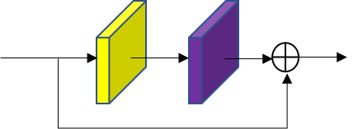
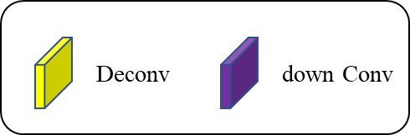
Introduction
Related work
Proposed method
Overview
Outer loop
Inner loop
CG
We use one deconvolution layer and one down-sampling convolution layer with a short residual connection to construct an iteratively up- and down-sampling block.
Such up- and down-sampling structure is proved to effectively address the mutual mapping between low and high-resolution image by DBPN [3].
Experiment
Result
Conclusion

Slide 17
Introduction
Related work
We use 800 images from DIV2K and 2650 images from Flickr2K as our training data.
Use MATLAB to generate bicubic down-sampling (BI) LR images from its corresponding ground truth HR images.
For testing, we use five standard SR benchmarks: Set5, Set14, B100, Urban100, Manga109.
Proposed method
Experiment
Dataset prepare
Training details
Comparison
Result
Conclusion

Slide 18
Introduction
Related work
Subjects | Details
Patch size | 60 (for x2 scale), 50 (for x3 scale), 40 (for x4 scale)
Dataset | DIV2K, Flickr2K
# of Training images | 3450
Batch size | 16
Optimizer | ADAM ->(β1, β2) = (0.9, 0.999)
Learning rate | Initialize to 0.0002,decade to half every 200 epochs
Loss function | L1 loss
Data augmentation | Randomly flips and rotations (8 directions)
Machine | RTX 2080 Ti
Implementation | Pytorch
Proposed method
Experiment
Dataset prepare
Training details
Comparison
Result
Conclusion

Slide 19
Introduction
Related work
Proposed method
The numbers of convolution group (CG) are set to be 4 and the groups of rerouted features r is set to 2.
We experimentally find that different scale factor is suitable for different numbers of outer loop and inner loop. So, we especially use different setting for each scale
Experiment
Dataset prepare
Training details
Comparison
Result
Conclusion

Slide 20
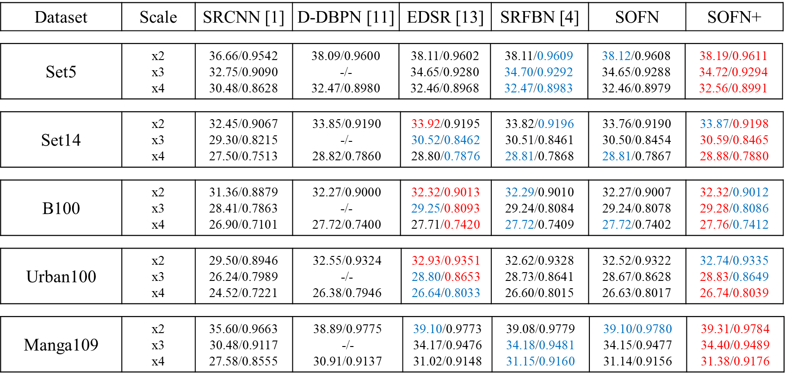
Introduction
Table 2. PSNR/SSIM results compared with SOFN
Related work
Proposed method
Experiment
Dataset prepare
Training details
Comparison
Result
Conclusion

Slide 21
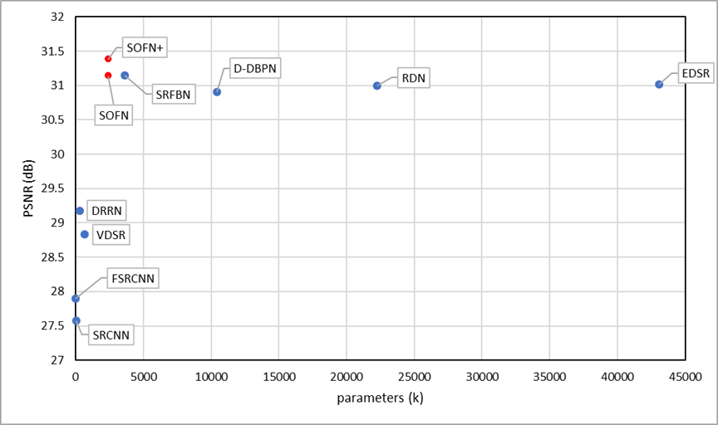
Introduction
Related work
Proposed method
Experiment
Dataset prepare
Training details
Comparison
Result
Conclusion
Figure 8. PSNR on Manga109 and number of parameters for x4 scale.
Notes:
66% srfbn
23% dbpn
5.5% edsr

Slide 22
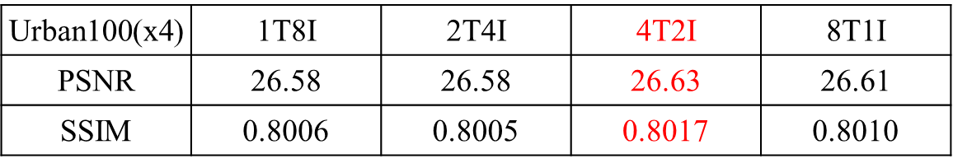
Introduction
Table 3 shows that the relationship of inner loop and outer loop on Urban100 for x4 scale.
Inner loop and outer loop are both indispensable.
Combining inner loop and outer loop appropriately can perform the highest PSNR and SSIM.
Related work
Proposed method
Experiment
Dataset prepare
Training details
Comparison
Table 3. comparison with difference numbers of inner loop and outer loop
Result
Conclusion

Slide 23
Introduction
For the convolution group (CG) design, we use iterative up- and down-sampling convolution to construct our CG. Here, we compare such structure with simply stacking common 7x7 convolution and see the effect of the structure.
Related work
Proposed method
Table 4. Urban100 comparison of different convolution group design
Experiment
Urban100(x4) | Common conv | Iterative updown (ours)
PSNR | 26.03 | 26.63
SSIM | 0.7843 | 0.8017
Dataset prepare
Training details
Comparison
Table 5. B100 comparison of different convolution group design
Result
B100(x4) | Common conv | Iterative updown (ours)
PSNR | 27.56 | 27.72
SSIM | 0.7351 | 0.7402
Conclusion

Slide 24
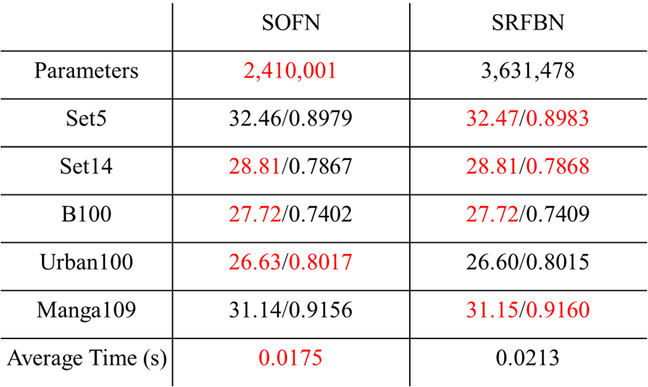
Introduction
Because we adopt SRFBN [1] as our network backbone, we want to especially compare the our SOFN with SRFBN.
Related work
Table 6. comparison of PSNR / SSIM and running time of SOFN and SRFBN
Proposed method
Experiment
Dataset prepare
Training details
Comparison
Result
Conclusion

Slide 25
Introduction
Considering we also use the concept of the multiple feedback mechanism of GMFN [2]. So, here we especially compare GMFN [5] with our SOFN to verify the effectiveness of our model.
Related work
Proposed method
Experiment
Dataset prepare
Training details
Comparison
Result
Conclusion
[2] Q. Li, Z. Li, L. Lu, G. Jeon, K. Liu, X. Yang, “Gated Multiple Feedback Network for Image Super-Resolution,”
In BMVC, 2019

Slide 26
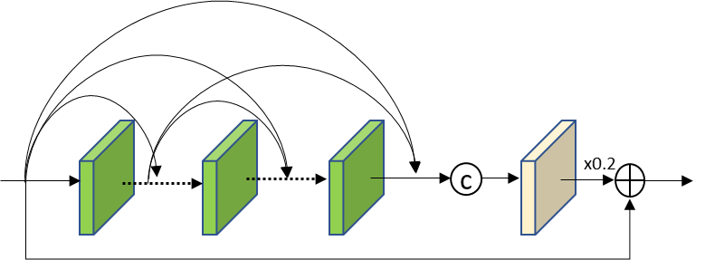
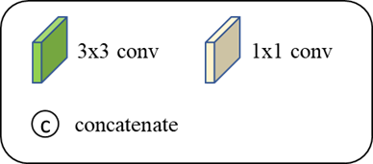
We denote the modified model as SOFN_RDB to indicate that the CG is replaced with RDB now.
Following GMFN [2], we set eight 3x3 convolution layers with dense connection and set the residual scaling factor to 0.2. We set the outer loop T to 2 same with GMFN [2] and set inner loop I to 2. The numbers of the RDBs are set to 4.
Introduction
Related work
Proposed method
Experiment
Dataset prepare
Training details
Comparison
Result
Conclusion
Figure 9. The schema of the residual dense block (RDB)

Slide 27
Introduction
Related work
Table 7. comparison of PSNR / SSIM and running time of SOFN_RDB and GMFN
Proposed method
 | SOFN_RDB | GMFN
Parameters | 5,770,561 | 9,864,152
Set5 | 32.61/0.8997 | 32.58/0.8994
Set14 | 28.86/0.7883 | 28.85/0.7881
B100 | 27.77/0.7424 | 27.75/0.7419
Urban100 | 26.78/0.8065 | 26.73/0.8052
Manga109 | 31.37/0.9184 | 31.25/0.9171
Average Time (s) | 0.0281 | 0.0204
Experiment
Dataset prepare
Training details
Comparison
Result
Conclusion
Notes:
nearly 41.5% parameters fewer than GMFN

Slide 28
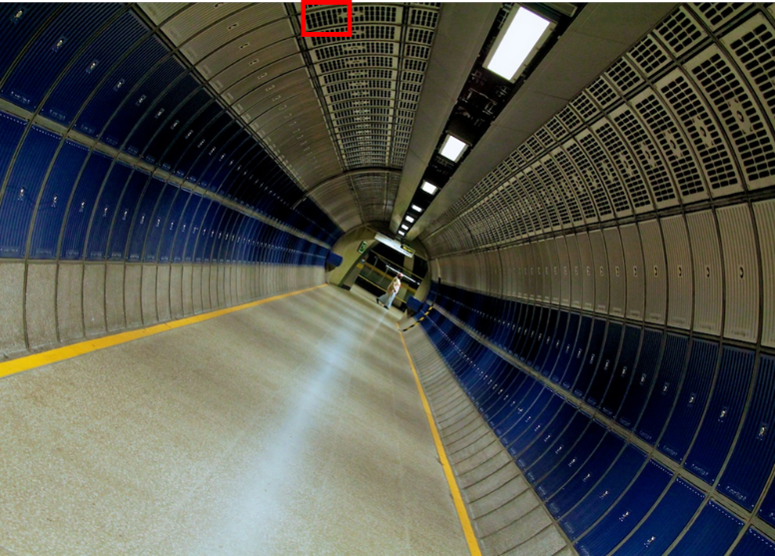






Introduction
Related work
Proposed method
Experiment
‘img_078’ from Urban100
Result
Urban100
B100
Manga109
ground truth
SRCNN
EDSR
Conclusion
DBPN
SRFBN
SOFN (ours)

Slide 29
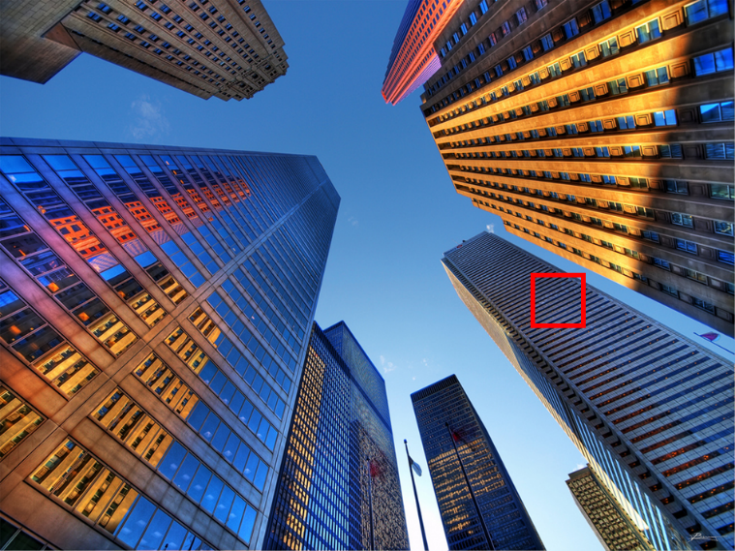






Introduction
Related work
Proposed method
‘img_012’ from Urban100
Experiment
Result
Urban100
B100
Manga109
ground truth
SRCNN
EDSR
Conclusion
DBPN
SRFBN
SOFN (ours)

Slide 30
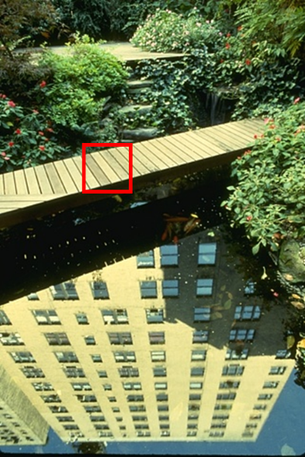






Introduction
Related work
Proposed method
‘148026’ from B100
Experiment
Result
Urban100
B100
Manga109
ground truth
SRCNN
EDSR
Conclusion
DBPN
SRFBN
SOFN (ours)

Slide 31







Introduction
Related work
Proposed method
Experiment
‘ShimatteIkouze_vol26’ from Manga109
Result
Urban100
B100
Manga109
ground truth
SRCNN
EDSR
Conclusion
DBPN
SRFBN
SOFN (ours)

Slide 32
Introduction
Related work
We proposed a new structure for image SR named a second order feedback network (SOFN) to reuse the hidden layer two times for reducing parameters and maintaining the competitive results.
SOFN consists of two part: the inner loop and the outer loop. The inner loop aims to deepen the sub-network depth and the outer loop aims to feedback the high-level features to refine the low-level features.
Proposed method
Experiment
Result
Conclusion

Slide 33
Reference
[1] Z. Li, J. Yang, Z. Liu, X. Yang, G. Jeon, W. Wu, “Feedback Network for Image Super-Resolution,”
In CVPR, 2019
[2] Q. Li, Z. Li, L. Lu, G. Jeon, K. Liu, X. Yang, “Gated Multiple Feedback Network for Image Super-Resolution,” In BMVC, 2019
[3] M. Haris, G. Shakhnarovich, and N. Ukita, “Deep Back-Projection Networks For Super-Resolution,” In CVPR, 2018

Slide 34
Questions and Answers

